Slide 1


Asian Boxing
Extraordinary Congress
Electoral Congress
Bangkok 2025

Slide 2


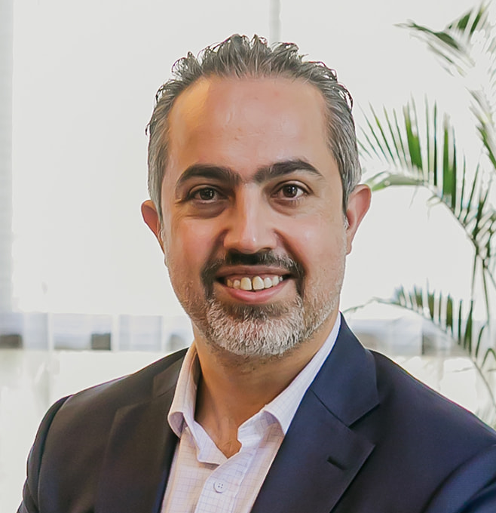
Your Speaker Today :
MR. Ali Salameh
Interim Secretary General

Slide 3

Agenda
Asian Boxing Extraordinary Congress – Official Agenda
Date: August 2, 2025
Venue: The Grand Four Wings Hotel, Bangkok, Thailand
1. Opening Session
09:00 – 09:15: Opening Speech by Mr. Pichai Chunhavajira
09:15 – 09:25: Welcoming Speech by the President of World Boxing
2. Administrative Matters
09:25 – 09:40: Roll Call of Delegates
3. Reports
09:40 – 10:20: Progress Report by Mr. Ali Salameh
4. Election Proceedings
10:20 – 10:30: Introduction of the Election Committee
10:30 – 10:40: Roll Call (for voting eligibility)
10:40 – 11:00: Election of the President
11:00 – 11:20: Election of the Vice President
11:20 – 11:50: Election of Regional Members (5 Members)
11:50 – 12:10: Election of Independent Members (4 Members)
12:10 – 12:20: Election of Committees
5. Closing Session
12:20 – 12:30: Closing Remarks
12:30 – 12:40: Closing Speech by Mr. Pichai Chunhavajira

Slide 4
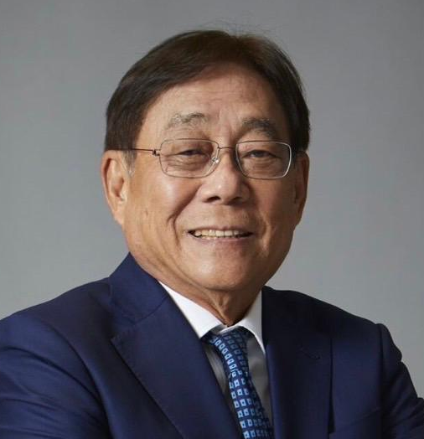
Opening Session
Opening Speech by
Mr. Pichai Chunhavajira

Slide 5
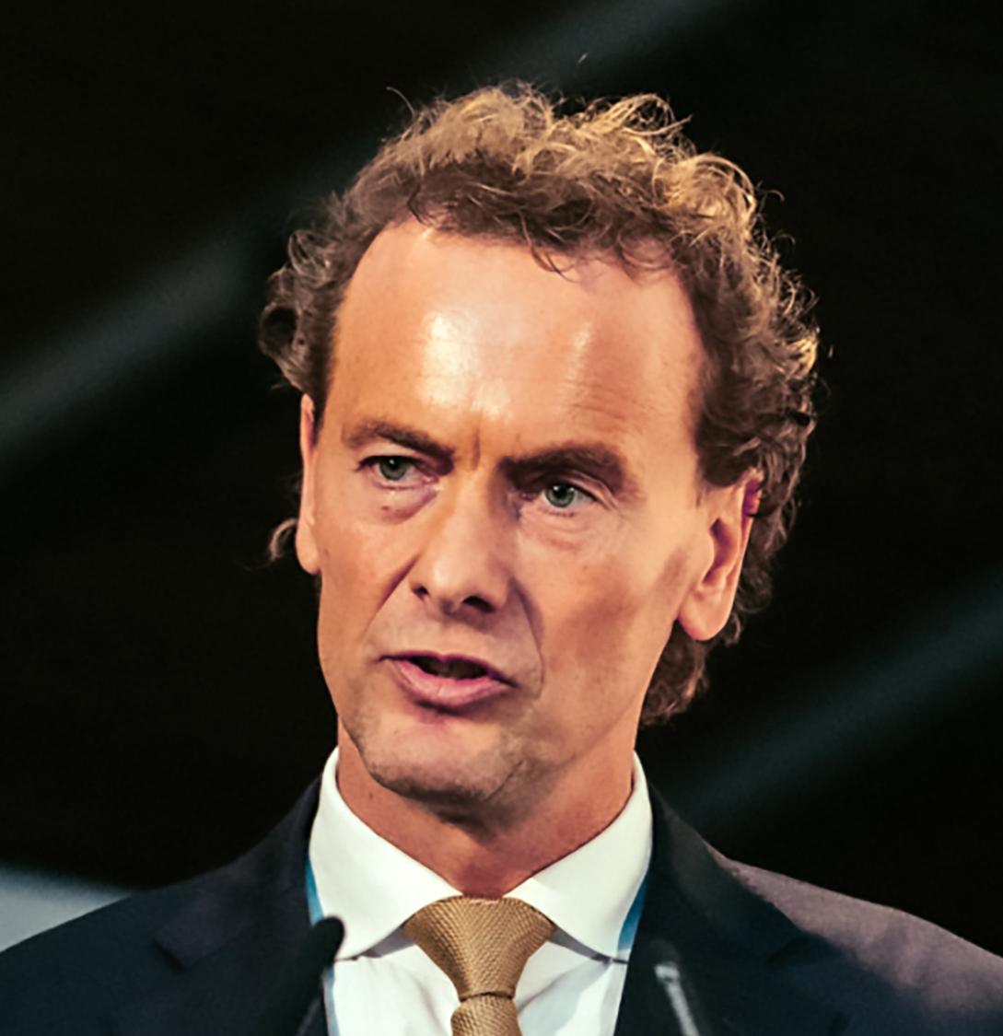
Opening Session
Welcoming Speech by
The President of World Boxing
Mr. BORIS VAN DER VORST

Slide 6
ADMINISTRATIVE MATTERS
ROLL CALL OF DELEGATES

Slide 7
AFGHANISTAN BOXING FEDERATION
ASSOCIATION OF BOXING ALLIANCES IN THE PHILIPPINES
BHUTAN BOXING FEDERATION
BOXING ASSOCIATION OF KOREA
BOXING FEDERATION OF INDIA
CAMBODIA BOXING FEDERATION
CHINESE BOXING FEDERATION
CHINESE TAIPEI BOXING ASSOCIATION
FÉDÉRATION LIBANAISE DE BOXE
INDONESIAN BOXING FEDERATION
IRAN BOXING FEDERATION
IRAQI BOXING FEDERATION
JAPAN BOXING FEDERATION
JORDAN AMATEUR BOXING ASSOCIATION
KAZAKHSTAN BOXING FEDERATION
LAO BOXING FEDERATION
MACAO BOXING GENERAL ASSOCIATION (ASSOCIAÇÃO GERAL DE BOXE DE MACAU)
MALAYSIA BOXING FEDERATION
MONGOLIAN BOXING FEDERATION
MYANMAR BOXING FEDERATION
NATIONAL BOXING FEDERATION OF THE KYRGZ REPUBLIC
NEPAL BOXING ASSOCIATION
PAKISTAN BOXING FEDERATION
PALESTINE BOXING FEDERATION
SAUDI BOXING FEDERATION
SINGAPORE BOXING ASSOCIATION
SYRIAN ARAB BOXING FEDERATION
THAILAND BOXING ASSOCIATION
THE BOXING FEDERATION OF TURKMENISTAN
THE BOXING ASSOCIATION OF HONG KONG, CHINA LIMITED
UAE BOXING FEDERATION
UZBEKISTAN BOXING FEDERATION

Slide 8
PROGRESS REPORT BY
MR. ALI SALAMEH
REPORT

Slide 9
PROGRESS
REPORT
To: Extraordinary Congress
From: Ali Salameh, Interim Secretary-General
Subject: Organizational Progress, Achievements, and Strategic Outlook
Date: August 2, 2025
Location: Bangkok, Thailand

Slide 10
Introduction: Who We Are
Asian Boxing is the first and only continental Confederation established under the governance of World Boxing, marking a bold step forward in the global reform of Olympic boxing. Formed in December 2024, we were created with a clear vision: to build a modern, transparent, and athlete-centered Confederation for Asia’s boxing community.
Since our founding:
World Boxing has doubled in membership, driven in large part by the momentum and credibility of our formation.
Asian Boxing has become the only continental body to organize official Championships under World Boxing.
We are now 32 member nations strong, with structured governance, a ratified constitution, and two major competitions within first eight months.

Slide 11
Key Achievements & Milestones
Inaugural Championship – Amman 2025
▪ Held April 17–30, 2025 in Jordan
▪ 17 participating countries, 300+ athletes and officials
▪ First-ever continental Championship under World Boxing
Upcoming U19 & U22 Championship – Bangkok 2025
▪ July 30 – August 12, 2025
▪ 397 boxers, 160 coaches, 26 countries, 2 age divisions
▪ Strategic focus on youth and Olympic pathways
Constitution Ratified & Democratic Structure Established
▪ Adopted April 26, 2025 at Virtual Congress in Amman
▪ Constitution Commission completed full mandate

Slide 12
32 National Federations Joined
▪ Rapid growth from 18 to 32 countries since launch
MOU Signed with Olympic Council of Asia (OCA)
▪ Strengthens alignment with Olympic values and development
Boxing Secured for 2025 Asian Youth Games in Bahrain
▪ Major breakthrough for youth engagement
Active Commissions Supporting Growth
▪ Competition Commission met twice; supports event planning
▪ Constitution Commission concluded work and delivered final draft
Digital Tools Launched
▪ Official website: Over 29,000 visitors
▪ Athlete registration & database system: Fully functional

Slide 13
Social Media Growth
▪ 10 million views, 2 million in reach since January 2025
▪ Daily engagement across Instagram, Facebook, YouTube, TikTok and X
First to Host Continental Events Under World Boxing
▪ Setting the standard for competitive structure and transparency
Operational Costs Covered by President Pichai Chunhavajira
▪ 100% of costs funded to date, ensuring continuity without delay
Official Registration with World Boxing Submitted
▪ On track for full international recognition

Slide 14
Thailand International Boxing Training Center Partnership
▪ In partnership with the Thailand Boxing Association, the Olympic Council of Asia (OCA), and the Sports Authority of Thailand, the upcoming Thailand International Boxing Training Center, a USD 20.5 million project spearheaded by President Pichai will serve as a regional hub for high-performance training, coaching education, and development programs for athletes and officials across Asia.

Slide 15
Challenges & Solutions
Shortage of Certified Officials (Amman)
▪ New regional training and certification program in development.
Operational Gaps at World Boxing
▪ Continued dialogue and collaboration to support federation needs
Scoring System Costs
Governance & the Elections
The Election Commission was formed and has met regularly to oversee the integrity, transparency, and fairness of the electoral process.
A strong and diverse list of candidates has been published, reflecting the democratic spirit of the new Confederation.
In line with our commitment to gender equality, the candidate list meets the required gender representation criteria as defined in our Constitution.
The first full election of leadership marks a historic milestone in the establishment of a democratic and inclusive governing structure for boxing in Asia.

Slide 16
Outlook
In just eight months, Asian Boxing has laid the foundations of a credible, inclusive, and professionally governed Confederation. With major championships delivered, youth development underway, and Olympic alignment secured, we are well-positioned to lead boxing in Asia into a new era, on principle, in partnership, and with purpose

Slide 17
Election Proceedings
Introduction of the Election Committee
Olympic Council of Asia (OCA): Assoc. Prof. Dr. Supitr Samahito - OCA Executive Board Member
World Boxing: Mr. Mke McAtee, Secretary General
Asian Boxing: Mr. Ali Salameh, Secretary General

Slide 18
ELECTION PROCEEDING
Roll call (for voting eligibility)

Slide 19
ELECTION PROCEEDINGS
Roll call AGAIN

Slide 20
Election Proceedings
Election of the President
Candidates:
Pichai Chunhavajira – Thailand Boxing Association

Slide 21
Election Proceedings
Election of the (2) Vice Presidents
Female Candidates:
Fatima Jbara Ahmed Faqeyat – Palestine Boxing Federation
Male Candidates:
Tatsuya Nakama – Japan Boxing Federation
Darkhan Kyzaibayev – Kazakhstan Boxing Federation
Saken Polatov – Uzbekistan Boxing Federation
Victorico Vargas – Association of Boxing Alliances in the Philippines

Slide 22
Election Proceedings
Election of Regional Members (5 Members)
Southeast:
Fairuz Bin Mohamed – Singapore Boxing Federation
Chaiwat Chotima – Thailand Boxing Association
Victorico Vargas – Association of Boxing Alliances in the Philippines
East:
Tatsuya Nakama – Japan Boxing Federation
Lou Kit Long– Macau Boxing Federation
Bayanmunkh Maidar – Mongolian Boxing Federation
Bo Han – Chinese Boxing Federation
May Lung-Hsien Wu – Chinese Taipei Boxing Association
South:
Muhammad Khalid Mahmood – Pakistan Boxing Federation
Ajay Singh – Indian Boxing Federation
West:
Ali Takleef Shaheed – Iraq Boxing Federation
Seyedroohollah Hosseini – Iran Boxing Federation
Arifa Darwish Musallam Bseiso – Jordan Boxing Association
Central:
Rauan Igenev – Kazakhstan Boxing Federation
Shohid Tillaboev – Uzbekistan Boxing Federation
Durdymammet Kuljayev – Turkmenistan Boxing Federation

Slide 23
Election Proceedings
Election of Independent Members (4 Members)
Tatsuya Nakama – Japan Boxing Federation
Rauan Igenev – Kazakhstan Boxing Federation
Lou Kit Long– Macau Boxing Federation
Bayanmunkh Maidar – Mongolian Boxing Federation
Muhammad Khalid Mahmood – Pakistan Boxing Federation
Fairuz Bin Mohamed – Singapore Boxing Federation
Chaiwat Chotima – Thailand Boxing Association
Shohid Tillaboev – Uzbekistan Boxing Federation
Bo Han – Chinese Boxing Federation
Ali Takleef Shaheed – Iraq Boxing Federation
Ajay Singh – Indian Boxing Federation
May Lung-Hsien Wu – Chinese Taipei Boxing Association
Seyedroohollah Hosseini – Iran Boxing Federation
Arifa Darwish Musallam Bseiso – Jordan Boxing Association
Durdymammet Kuljayev – Turkmenistan Boxing Federation
Victorico Vargas – Association of Boxing Alliances in the Philippines

Slide 24
Election Proceedings
Election of Committees
Audit and Finance Committee : ( will be directly Board Member )
Candidates :
Darkhan Kyzaibayev – Kazakhstan Boxing Federation
Victorico Vargas – Association of Boxing Alliances in the Philippines
Judicial Committee :
Candidates :
Lou Kit Long – Macau Boxing Federation
Medical and Anti-Doping Committee
Candidates :
Mee Chai Inwood – Thailand Boxing Association

Slide 25
CLOSING SESSION
CLOSING REMARK
ALI SALAMEH

Slide 26
CLOSING SESSION
CLOSING SPEECH
MR. PICHAI CHUNHAVAJIRA

